Slide 1


FIELDRESERVE
Done By: Group 9
Members:
Osama Ahmad - 764000269
Mohammed Adil - 415006855
Araz Hafez - 433006827
Muhammed Rashid - 421007820

Slide 2

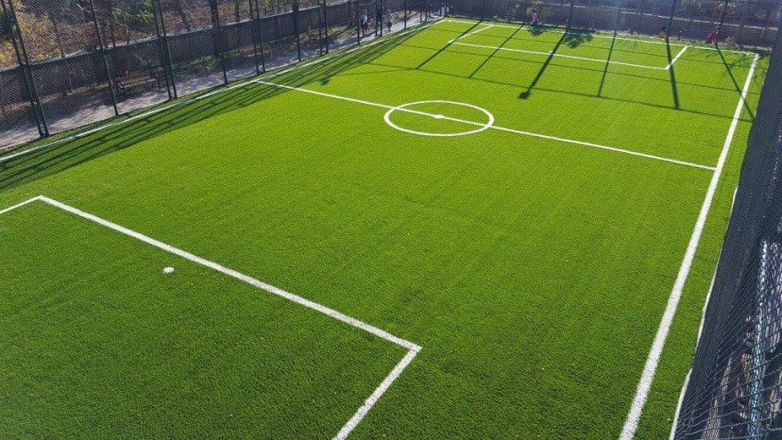

What Is our idea?
Our idea is to build a Digital Field Booking System called FieldReserve.
FieldReserve is a web-based application that allows sports enthusiasts and community groups to browse available sports fields and submit booking requests in a simple and conflict-free way.
Unlike complex scheduling platforms or phone calls, our system focuses on:
Simplified reservations
Clear field availability
Persistent user selections
The goal is to provide a safe, easy-to-use, and efficient solution for managing community sports field reservations.

Slide 3
How Will It Work?
Users browse available sports fields through a simple web interface
Availability is displayed automatically based on existing bookings
Users submit booking requests with selected date and field
The system validates requests and prevents basic conflicts
Send confirmation email to the user including date and time of the booking

Slide 4





User Scenario
Open FieldReserve
Availability
Submit/Manage
Stores Data
View
Keep Data
A user opens FieldReserve
The user checks available field-related information
The user submits or manages a reservation
The system stores the data in the backend
The manager can view, update, search, or delete records
The application keeps the booking data organized through the database

Slide 5
Application Architecture
Backend Layer:
Frontend Layer:
Spring Boot application
REST controllers
Service classes
Repository interfaces
Standalone HTML pages
CSS / Bootstrap styling
JavaScript using fetch()
Forms, tables, buttons, and search inputs
Database Layer:
MySQL database
Database name: iste240
JPA entity classes
Spring Data JPA repositories

Slide 6

Backend Request Flow
Example: Add User
User fills the form in users.html
JavaScript sends a POST request using fetch()
UserRestController receives the request
UserService applies the business logic
UserRepository saves the record using JPA
MySQL stores the user in the users table
The frontend refreshes the table and shows a success message

Slide 7
Database and Data Model
User
Reservation
userId
fullName
email
phone
role
password
createdAt
reservationID
reservationDate
startTime
endTime
totalCost
reservationStatus
paymentStatus
Field
Location
fieldID
fieldName
fieldLocation
hourlyRate
availabilityStatus
locationID
locationName
locationArea
locationCity

Slide 8

User Module Implementation
Implemented Features:
View all users
Search users by email
Add a new user
Edit an existing user
Delete a user
Store user data in MySQL
Display user records in a responsive table
Main Classes:
User entity
UserRepository
UserService
UserRestController
users.html
users.js

Slide 9



REST API Endpoints
Method
Endpoint
Purpose
GET
/api/users
Get all Users
GET
/api/users/{id}
Get one user by ID
GET
/api/users/search?email=...
Search users by email
POST
/api/users
Create a new user
PUT
/api/users/{id}
Update an existing user
DELETE
/api/users/{id}
Delete a user

Slide 10

JPA and Repository Implementation
Repository Methods
findAll()
findById()
findByEmailContainingIgnoreCase()
findByEmail()
Custom JPQL query: findUsersByRole()
Update query: updatePhoneById()
deleteById()
Database Configuration
MySQL database: iste240
Hibernate: ddl-auto=update
Database created automatically if it does not exist

Slide 11
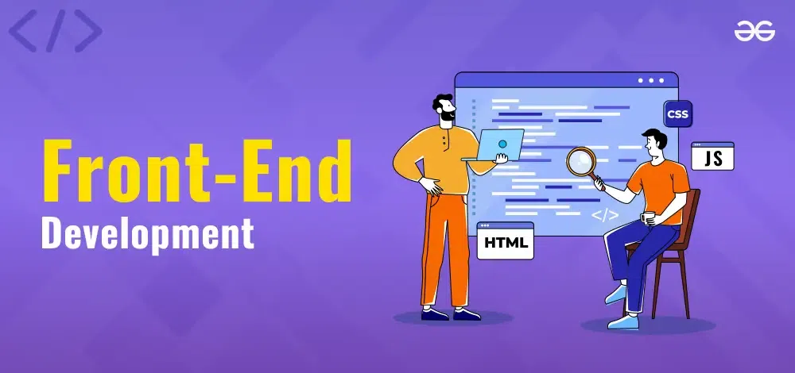
Osama Ahmad
fRONTEND DESIGN
Frontend Features
Landing page with navigation links
User management page
Bootstrap styling
Responsive table layout
Add/edit form
Search bar
Edit and delete buttons for each row
Loading message
Success and error alerts
Frontend Technologies
HTML
CSS
Bootstrap
JavaScript
fetch() API

Slide 12
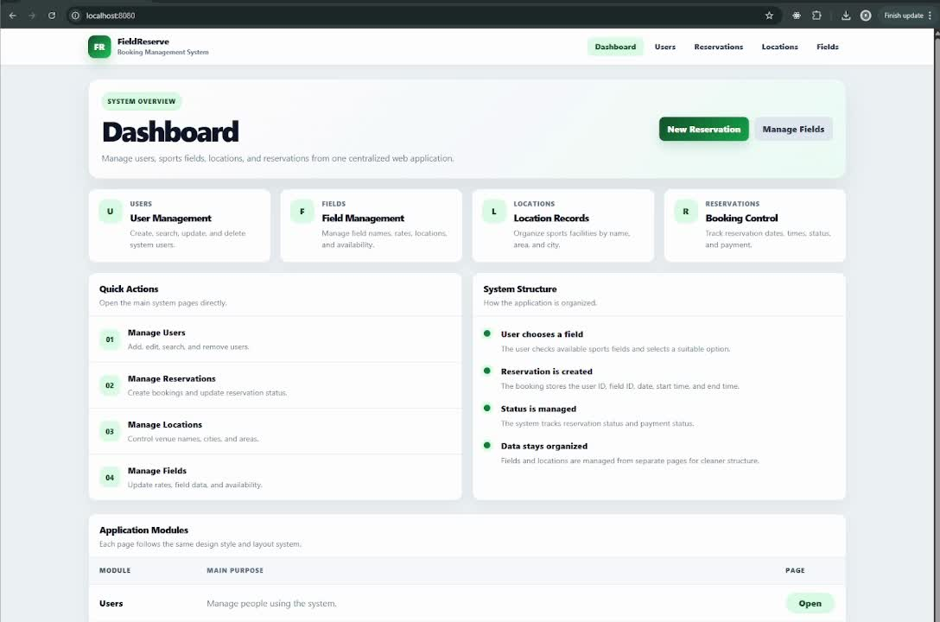
Demo:
Demo:

